Slide 1

Web Application Security
Ankit Trivedi

Slide 2
Agenda
What is Owasp
OwaspTop10 Vulnerabilities
Types of access control
Broken access control
What is IDOR
Impact of Vulnerability
How to prevent
Resources

Slide 3
What is Owasp
The Open Worldwide Application Security Project (OWASP) is a nonprofit foundation that works to improve the security of software
The OWASP Foundation launched on December 1st, 2001
Vision: No more insecure software
Mission: To be the global open community that powers secure software through education, tools, and collaboration.

Slide 4
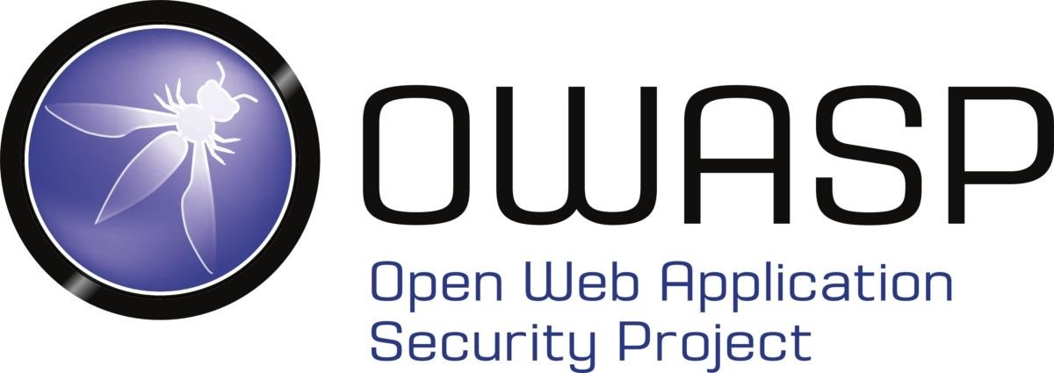
OwaspTop10
OWASP Top 10 - 2013 | OWASP Top 10 - 2017 | OWASP Top 10 - 2021
A1 – Injection | A1 – Injection | A1 – Broken Access Control
A2 – Broken Authentication and Session Management | A2 – Broken Authentication | A2 – Cryptographic Failures
A3 – Cross-Site Scripting (XSS) | A3 – Sensitive Data Exposure | A3 - Injection
A4 – Insecure Direct Object References | A4 – XML External Entities (XXE) | A4 – Insecure Design
A5 – Security Misconfiguration | A5 – Broken Access Control | A5 – Security Misconfiguration
A6 – Sensitive Data Exposure | A6 – Security Misconfiguration | A6 – Vulnerable and Outdated Components
A7 – Missing Function Level Access Control | A7 – Cross-Site Scripting (XSS) | A7 – Identification and Authentication Failures
A8 – Cross-Site Request Forgery (CSRF) | A8 – Insecure Deserialization | A8 – Software and Data Integrity Failures
A9 – Using Components with Known Vulnerabilities | A9 – Using Components with Known Vulnerabilities | A9 – Security Logging and Monitoring Failures
A10 – Unvalidated Redirects and Forwards | A10 – Insufficient Logging & Monitoring | A10 – Server-Side Request Forgery (SSRF)

Slide 5
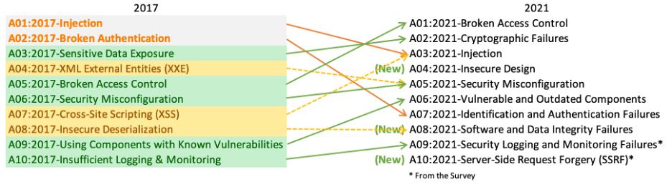
Green arrows are vulnerabilities that were promoted.
Orange arrows are vulnerabilities that were demoted.
Yellow broken line arrows are vulnerabilities removed and merged into other categories.

Slide 6
Broken Access Control vulnerabilities arise when users can act outside of their intended permissions. This typically leads to sensitive information disclosure, unauthorized access and modification or destruction of data.
Authentication +Session management+ Access control

Slide 7



Types of access control
Admin
Vertical Access Control is used to restrict access to functions not available for other users in the organization.
Regular User

Slide 8



Cont..
Horizontal Access Control enables different users to access similar resource types.
Regular User #1
Regular User #2

Slide 9




Cont..
Context-Dependent Access Control restricts access to functionality and resources based on the state of the application or the user's interaction with it.
1
/confirm
Confirmation
Are you sure you want to delete the user Carlos?
Yes No
2
Delete Users
Carlos
David
/delete
User Successfully Deleted.
Delete
Delete

Slide 10
What is IDOR
Insecure direct object references (IDOR) are a type of access control vulnerability that arises when an application uses user-supplied input to access objects directly.
>https://insecure-website.com/static/12144.txt
>https://insecure-website.com/customer_account?customer_number=132487
URL Tempering, Body Manipulation, Path Traversal, Cookie or JSON ID Manipulation

Slide 11
Impact of Access Control Vulnerability
Unauthorized access to the application.
Confidentiality – Access to other users’ data.
Integrity – Access to update other users’ data
Availability – Access to delete users.
Can sometimes be chained with other vulnerabilities to gain remote code execution on the host operating system.

Slide 12
Spot the Vulnerability?
public boolean deleteOrder(Long id) {
Order order = orderRepository.getOne(id);
if (order == null) {
log.info("No found order");
return false;
}
User user = order.getUser();
orderRepository.delete(order);
log.info("Delete order for user {}", user.getId());
return true;
}
Answer: No verification is performed on line 8 to see if the order has been made by the currently logged-in user.

Slide 13
How to Prevent
Use a security-centric design where access is verified first and ensure all requests go through an access control check.
Except for public resources, deny access by default.
Apply the principal of least privilege throughout the entire application.
Consider using attribute or feature-based access control checks instead of role-based access control.
Access control checks should always be performed on the server side.

Slide 14
Resources
Code Source:: https://www.securecodewarrior.com/blog/coders-conquer-security-owasp-top-10-api-series-broken-object-level-authorization
https://owasp.org/www-project-top-ten/
https://portswigger.net/web-security/access-control#what-is-access-control

Slide 15

THANK YOU!!

